Slide 1
How to upadate an image in database using php
1 Select image from system
2 C U R D
by:
G Bhanu Prakash

Slide 2
Introduction: I am going to explain with example How to upadate an image in database using php from the Grid View using Sql Server as a Back end database we create a form that takes an image and some text. When the user selects an image and enters some text and clicks the submit button, the data is submitted to the server. PHP now grabs the image and saves it in a folder in the project, and then saves the text in the database together with a link pointing to the image in the folder. In the web.config file create the connection string to connect our application to the sql server database

Slide 3
Description:
.How to upload image file through file Upload control and Bind/Load/ Fill in GridView Data control.
.How to upload and Delete image file from phpMyAdmin.
.How to delete the image file permanently from the server folder.
.How to set multiple Data key names in phpMyAdmin.
and How to get/read/fetch them in phpMyAdmin.

Slide 4
Implementation:
Now let’s create an PHP code and it is a server side scripting language that is used to develop Static websites or Dynamic websites or Web applications.
First of all we need to create the Database in Sql server
e.g: “My Database” and in this create a table with the following columns and data types and name it ”Images”.

Slide 5
Objectives
1. Add / Edit Form Submit:
The submitted form data is validated to check the empty field value.
The insert and update methods of the DB class is used to update gallery data in the database.
Check and validate the files extension using pathinfo() function in PHP.
Upload multiple images to server using move_uploaded_file() function in PHP.
Insert the uploaded image and gallery ID in the database using insert Image() method of the DB class.
2. Inactive Gallery :
Update and set the gallery status to 0 in the database.
The update() method of the DB class is used to update status field value in the database.

Slide 6
3. Activate Gallery:
Update and set the gallery status to 1 in the database.
The update() method of the DB class is used to update status field value in the database.
4. Delete Gallery:
Delete gallery and images data from the database.
Remove images from the directory of the server.
The delete() and delete Image() methods of the DB class is used to delete gallery and images data from the database.
5. Delete Image:
Delete image data from the database.
Remove image file from the directory of the server.
The delete Image() method of the DB class is used to delete image data from the database

Slide 7
Source code:
<?php
// Create database connection
$db = mysqli_connect("localhost", "root", "", "image_upload");
// Initialize message variable
$msg = "";
// If upload button is clicked ...
if (isset($_POST['upload'])) {
// Get image name
$image = $_FILES['image']['name'];
// Get text
$image_text = mysqli_real_escape_string($db, $_POST['image_text']);
// image file directory
$target = "images/".basename($image);
$sql = "INSERT INTO images (image, image_text) VALUES ('$image', '$image_text')";
// execute query
mysqli_query($db, $sql);
if (move_uploaded_file($_FILES['image']['tmp_name'], $target)) {

Slide 8
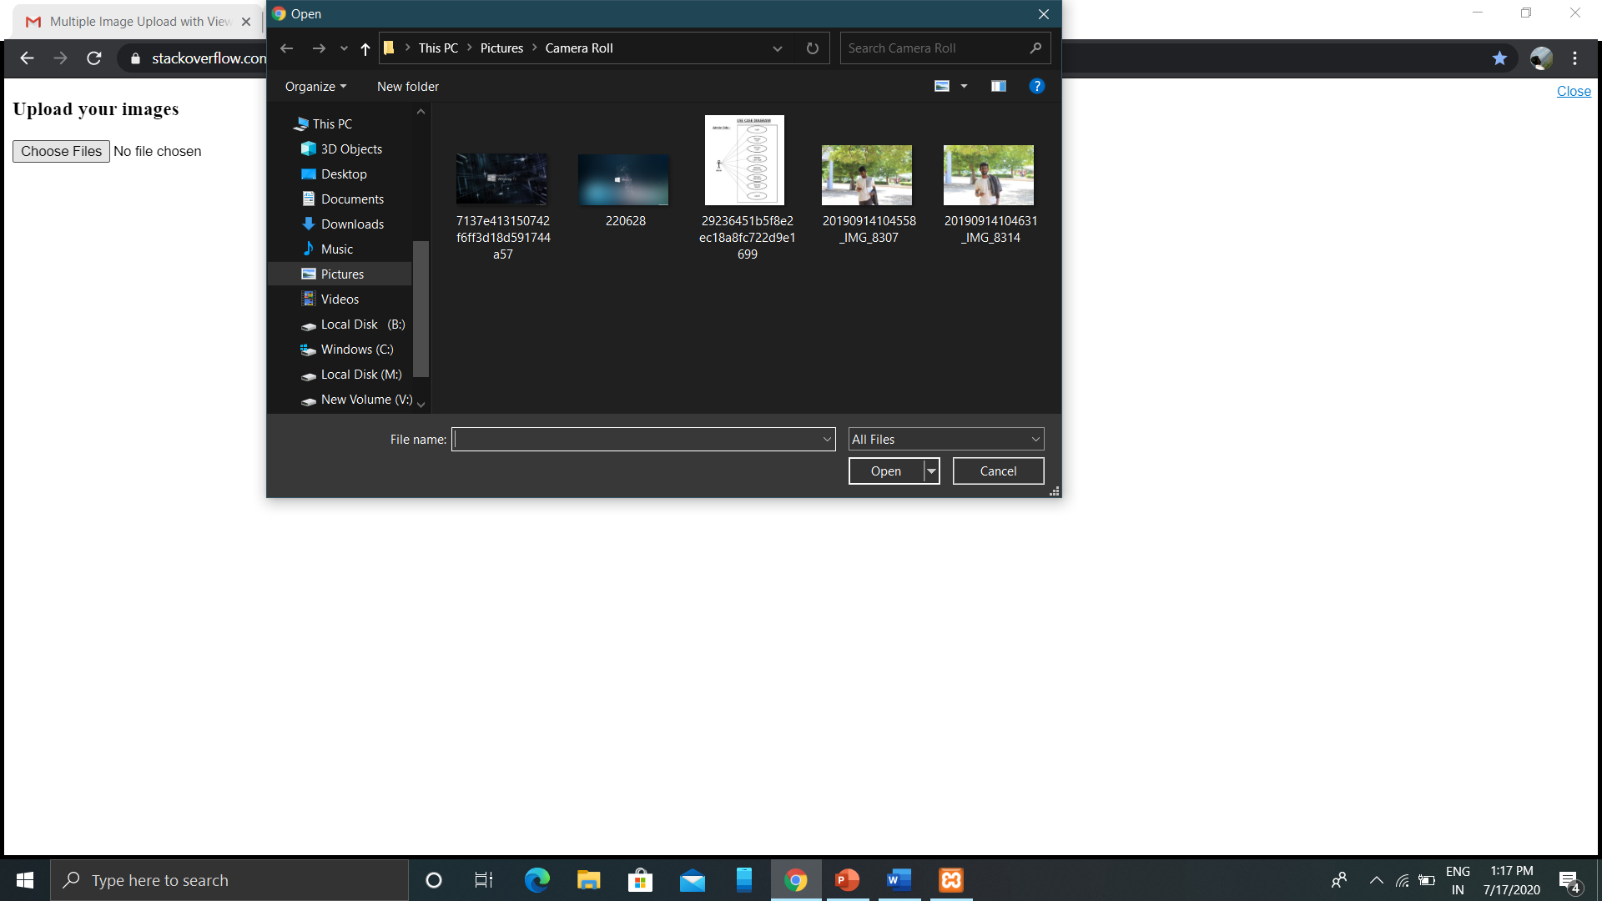
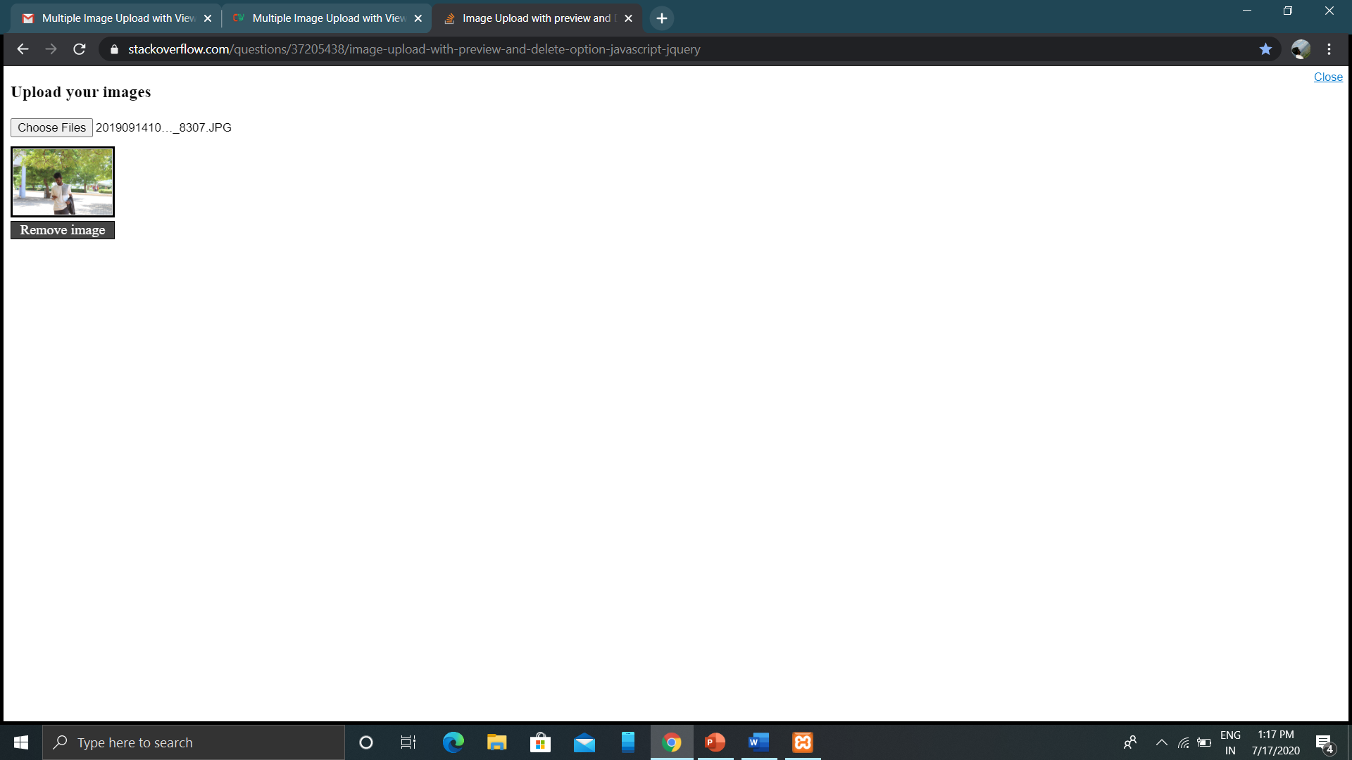
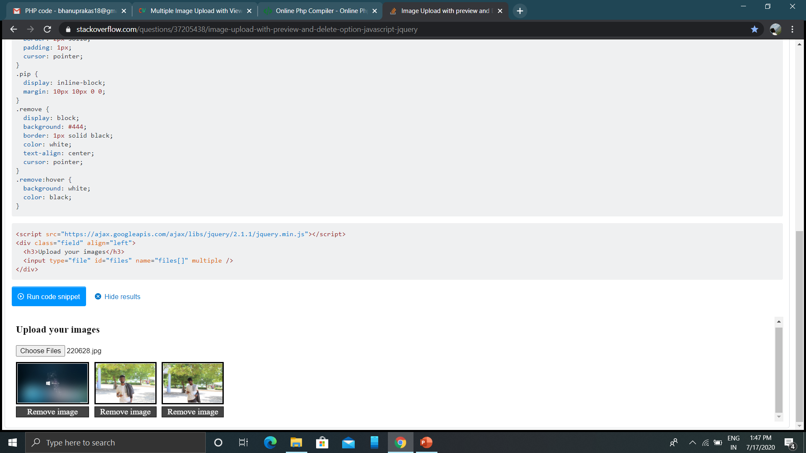

Slide 9
C U R D :
CRUD operation is the most used functionality in the web application. Almost, all web application uses CRUD functionality to manage and manipulate data in the database. The CRUD (Create, Read, Update and Delete) functionality can be easily implemented using PHP and MySQL. PHP CURD with MYSQL helps to handle view, add, edit, and delete data from the database.
Search and Pagination is a very useful feature to make the data list user-friendly. When you add CRUD functionality to the website, search and pagination are the must-have functionality for the CRUD data list. In this tutorial, we will show you how to implement PHP CRUD operations with search and pagination using MySQL.

Slide 10
Conclusion:
This multiple images upload management script is very useful for dynamic data management section in the web application. This script can be used for many purposes, like products management with multiple images using PHP and MySQL. You can easily enhance the functionality of this script and use in any data management section where multiple image upload functionality is needed.

